Slide 1

Deep Learning Project: Sentiment Analysis
By Dishari Dutta Chowdhury
NSTIW Kolkata
Guidance: Ms. Arpita Roy

Slide 2
Project Overview & Goals
Abstract
Developed a deep learning model for sentiment analysis of IMDb movie reviews. Classified reviews as positive or negative using an LSTM network, achieving 87% accuracy. Covered the full ML pipeline: data loading, preprocessing, model building, training, evaluation, and prediction.
1
2
3
Problem Statement
Use Case
Benefits
Automate text sentiment classification; manually analyzing text is impractical.
Automated analysis of feedback for businesses, marketing, content creators.
Gain rapid insights, improve products/services, manage online communities.

Slide 3

Solution Approach: LSTM Networks
Literature Review
Proposed Solution
Evolved from lexicon/traditional ML to deep learning. LSTMs (RNNs) overcome vanishing gradient, capture long-range dependencies in text for nuanced sentiment. Chosen for proven text classification effectiveness.
Supervised deep learning with LSTM (TensorFlow/Keras) for binary text classification.
Load & pad IMDb dataset.
Construct Embedding, LSTM, and Dense layers.
Train and evaluate on unseen data.
Demonstrate with new reviews.
Why LSTM?
Ideal for sequential data like text. Understands context and long-term dependencies to determine sentiment, even for negations.

Slide 4
Technical Requirements & Data
Technology Stack
Dataset Description
Language: Python 3.x
Source: IMDb movie reviews (TensorFlow datasets)
Libraries: TensorFlow, Keras, NumPy, Matplotlib
Size: 50,000 reviews (25k train, 25k test)
Hardware: Standard computer (GPU recommended)
Features: Text review, binary sentiment (0/1)
Software: Jupyter Notebook / Python IDE
Balance: Perfectly balanced (equal positive/negative)
Preprocessing: Already integer-encoded, top 10k words
Data Preprocessing: Reviews padded to uniform 256 words; 20% of training data used for validation.

Slide 5
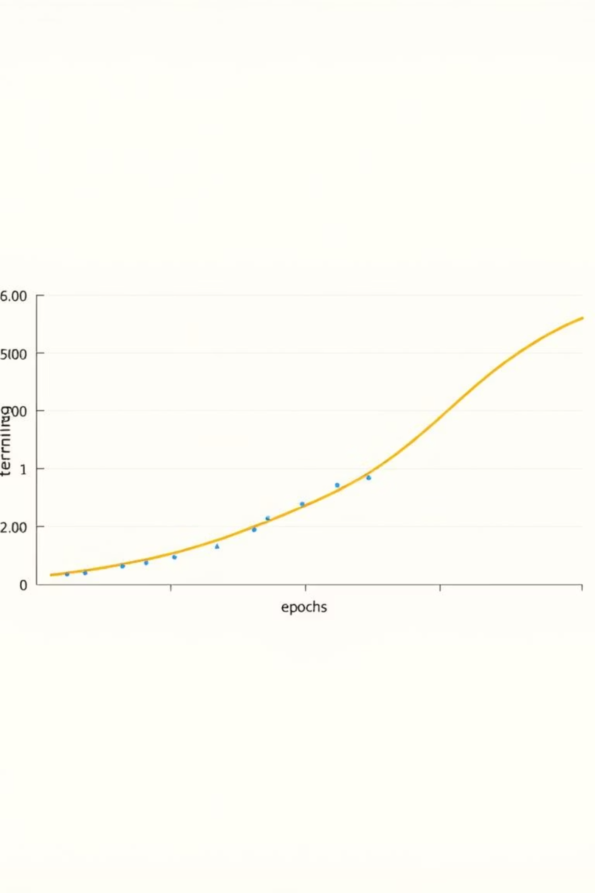
Exploratory Data Analysis (EDA)
Key trends observed:
Balanced dataset: Prevents classification bias.
Varied review lengths: Justified padding for uniform input tensors.
Primary EDA: Training and validation accuracy/loss plots.
Model learns effectively; validation accuracy tracks training, indicating no severe overfitting.

Slide 6
Model Architecture & Training
Model Building (Keras Sequential API)
Model Parameters
Input: Padded integer sequences of reviews
Epochs
10
Embedding Layer: vocab_size=10000, embedding_dim=16
Batch Size
512
LSTM Layer: 64 units
Dropout Layer: Rate of 0.5 (for regularization)
Train-Test Split
50:50 (dataset default)
Output Layer: Dense (1 unit, sigmoid activation)
Validation Split
20% of training data
Optimizer: Adam
Loss Function: Binary Crossentropy

Slide 7
Evaluation & Results
Model Evaluation
Results & Discussion
Metric: Accuracy
Accuracy: 87% is strong, demonstrating effective sentiment differentiation.
Result: ~87% on test set (25,000 reviews)
Additional: Mean Absolute Error (MAE) and Confusion Matrix for detailed performance.
Observation: Simple architecture + small embedding dimension worked well.
Mitigation: Dropout layer crucial for reducing overfitting.
Challenges Faced
Overfitting: Addressed with Dropout layer.
Maxlen: Optimal padding length (256) balanced information retention and training time.

Slide 8








Conclusion & Future Directions
Successful Implementation
Experiment with Advanced Models
LSTM model effectively implemented for sentiment analysis on IMDb data. Full ML pipeline established.
Explore Bidirectional LSTMs or Transformers (e.g., BERT) for enhanced accuracy.
Leverage Pre-trained Embeddings
Real-time Deployment
Deploy the model as a web API (Flask/FastAPI) for live sentiment analysis.
Integrate GloVe or Word2Vec to utilize broader text corpus knowledge.
References: TensorFlow Datasets (IMDb), TensorFlow & Keras Documentation.

